Slide 1
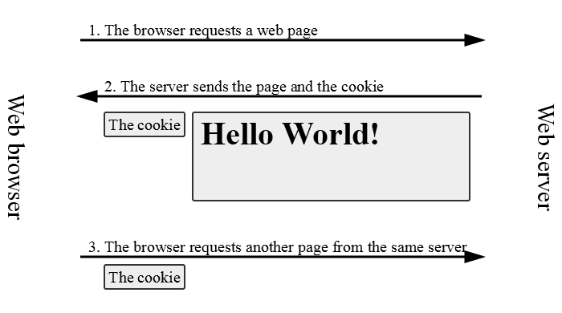
PHP Cookies
Cookies are a mechanism for storing data in the remote browser and thus tracking or identifying return users.
Notes:
‹#›

Slide 2
To set Cookie in PHP
PHP provided setcookie() function to set a cookie.
Cookies are part of the HTTP header, so setcookie() must be called before any output is sent to the browser.
Notes:
‹#›

Slide 3
SYNTAX
setcookie(name,[ value, expire, path, domain, security]);
Argument | Type | Default | Description
Name | String |  | To set the variable name and is stored in an environment variable called $_COOKIE or $HTTP_COOKIE_VARS variables. This variable is used while accessing cookies.
Value | String |  | To set the value of the named variable and is the data that you actually want to store.
Expire | Integer | 0 | specify a future time in seconds since 00:00:00 GMT on 1st Jan 1970. After this time cookie will become inaccessible. If this parameter is not set then cookie will automatically expire when the Web Browser is closed.
Path | String | '/' | Restrict the path that the cookie is available to. This value will be used when $path is not specified when you call the set() method.
Domain | String | null | Restrict the domain that the cookie is available to. This value will be used when $domain is not specified when you call the set() method.
Security | Boolean | false | Set to true if you only want to transmit cookies over secure connections.
Notes:
‹#›

Slide 4
Example
Here we can create a cookies for 1 days
<?php
$time = time() + (60*60*24);
Setcookies (“user”,”Radix web”,$time);
exit;
?>
Notes:
‹#›

Slide 5
To retrieve cookie
If your cookie is not expired yet, you can retrieve it using $_COOKIE or $HTTP_COOKIE_VARS as an associative array. The name of your stored cookie is the key and will let you retrieve your stored cookie value!
Example:
<?php
if(isset($_COOKIE['UsersName']) {
echo "Hello, ".$_COOKIE['UsersName']."! Welcome back!";
} else {
setcookie("UsersName",$name);
}
?>
Notes:
‹#›

Slide 6
Unset /Delete Cookie
To remove a cookie,simply overwrite with setcookie function using past time in expire.
SYNTAX:
setcookie ("name" , "value" , time () - 3600);
Notes:
‹#›

Slide 7
Problems with Cookies
.Browser can refuse to accept cookie.
.It adds network overhead to send lots of information.
.There are also limit to the amount of information can be sent.
Notes:
‹#›

Slide 8
PHP Sessions
A session allows to temporary store user information on the server. Ex, Cart items, user data.
A visitor accessing the web site is assigned a unique id, the so-called session id.
A session creates a file in a temporary directory on the server where registered session variables and their values are stored. This data will be available to all pages on the site during that visit.
NOTE:on the server, session data are stored as temporary files such as /tmp/sess_fcc17f071…
you can find out (or change) the folder where session data is saved using the session_save_path function
Notes:
‹#›

Slide 9
START SESSION:
At the beginning of your script, make a call to the session_start() function. Open the session with the session_start function, as follows:
SYNTAX:
<?php
session_start();
<html>
<body>
</body>
</html>
Notes:
‹#›

Slide 10
Storing and Accessing Variables
To save a variable in a session so that it’s available on later Web pages, store the value in the $_SESSION array, as follows:
SYNTAX:
$_SESSION[‘varname’] = “value”
The $_SESSION associative array reads/stores all session data
Use isset function to see whether a given value is in the session
EXAMPLE:
if (isset($_SESSION["points"])) {
$points = $_SESSION["points"];
print("You've earned $points points.\n");
} else {
$_SESSION["points"] = 0; # default
}
Notes:
‹#›

Slide 11
clear or destroy session
Destroy SESSION
If you wish to delete some session data, you can use the unset() or the session_destroy() function
session_destroy() will reset your session and you will lose all your stored session data. This function does not need any argument
unset() function to unset a session variable. its need argument
<?php session_start(); if(isset($_SESSION['cart'])) unset($_SESSION['cart']); ?> | <?php session_start(); session_destroy(); ?>
Notes:
‹#›

